Slide 1

EECS 482
Lab 5: Deadlock and Testing P2

Slide 2
Administrivia
Extra OH
This week
Project 2
Due 02/15
Review Session
TBD (02/18 or 02/19)
Midterm
02/22 6-8pm
Today: 02/10

Slide 3
New OH Policies
Starting Friday, February 10th (today)
New platform: https://eecsoh.eecs.umich.edu
Separate queues: BBB in-person, UGLi in-person, Virtual
We believe this will make OH more organized and efficient
During in-person office hours, we will only service in-person requests. Remote requests should only be put on the Virtual OH queue
Remote requests on in-person queues will be popped without being helped

Slide 4
New OH Policies (contd.)
If demand is high, we will randomize the queue order a few seconds after opening it
This is primarily done to prevent botting and ensure fairness regardless of internet connection quality
Students queuing for the first time in a day will be automatically prioritized over students that queue multiple times on the same day
Everyone's priority resets overnight
You will be able to join the queue again 10 minutes after the last time you were helped.
Your name will be anonymous to other students
(but not to the staff)

Slide 5
Agenda
Deadlock
Project 2 Testing

Slide 6
Deadlock

Slide 7
Conditions for deadlock
Limited resources
Not enough to serve all threads at once
No preemption
Cannot force threads to give up control
Hold-and-wait
Holding resource while waiting for other
Cyclical chains of requests
e.g. dining philosophers

Slide 8
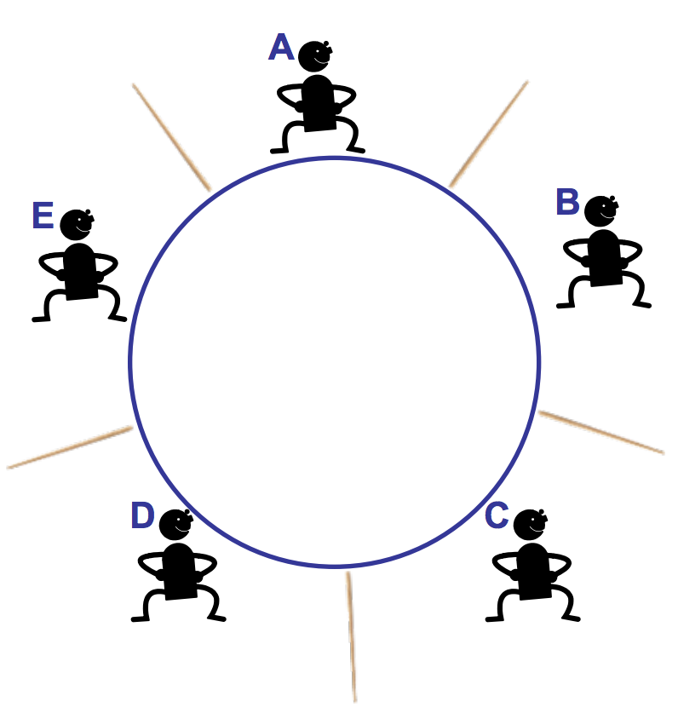
Dining philosophers
dine() {
waitFor(rightStick);
pickUp(rightStick);
waitFor(leftStick);
pickUp(leftStick);
monch();
}
Notes:
What conditions for deadlock are at play here?

Slide 9
Dining philosophers
dine() {
waitFor(rightStick);
pickUp(rightStick);
waitFor(leftStick);
pickUp(leftStick);
monch();
}
limited resources
Notes:
What conditions for deadlock are at play here?

Slide 10
Dining philosophers
dine() {
waitFor(rightStick);
pickUp(rightStick);
waitFor(leftStick);
pickUp(leftStick);
monch();
}
no preemption while eating
Notes:
What conditions for deadlock are at play here?

Slide 11
Dining philosophers
dine() {
waitFor(rightStick);
pickUp(rightStick);
waitFor(leftStick);
pickUp(leftStick);
monch();
}
hold-and-wait
Notes:
What conditions for deadlock are at play here?

Slide 12
Dining philosophers
dine() {
waitFor(rightStick);
pickUp(rightStick);
waitFor(leftStick);
pickUp(leftStick);
monch();
}
Cyclical acquisitions
Notes:
What conditions for deadlock are at play here?

Slide 13
Avoiding deadlock
We could detect deadlock:
e.g., detect cycles in resource graph
Preempt naughty threads
We could prevent deadlock:
Prevent hold-and-wait
Prevent cyclical acquisitions

Slide 14
Preventing hold-and-wait
Two approaches:
Threads grab all resources atomically, or none at all.

Slide 15

Preventing hold-and-wait
Two approaches:
Threads grab all resources atomically, or none at all.

Slide 16
Preventing hold-and-wait
Two approaches:
If a thread finds a busy resource, it releases everything and tries again.

Slide 17
Deadlock exercise: bank account transfers
Suppose you have a function for transferring funds from one account to another.
Each user account has a lock.
You must acquire the lock for both accounts before transferring funds.

Slide 18
Deadlock exercise: bank account transfers
std::map<int, mutex> locks; void transfer_money(int acct1, int acct2, int amount) { locks[acct1].lock(); locks[acct2].lock(); <transfer money> locks[acct2].unlock(); locks[acct1].unlock(); }
Can this deadlock?
Same issues as dining philosophers

Slide 19
Debugging Deadlock

Slide 20
Let's try it!

Slide 21
Project 2 Testing

Slide 22
Let's write a test case
Let's write a test case to test whether mutex::lock() provides mutual exclusion between threads
Mutual Exclusion: if one thread owns a mutex, no other thread should be able to acquire it
Specifically, other threads that call lock() should block
Let's test this out!

Slide 23
Let's write a test case
Thread A:
cout << "A pre-lock" << endl;
m.lock();
At this point, any other thread that calls lock() should block
How can we force a different thread to run so that we can test this?
thread::yield()

Slide 24
Let's write a test case
running_thread: B
ready_queue: A
blocked_queue:
Thread A:
cout << "A pre-lock" << endl;
m.lock();
thread::yield()
Thread B:
cout << "B pre-lock" << endl;
m.lock();
What should happen when thread B tries to lock the mutex?

Slide 25
Let's write a test case
running_thread: B
ready_queue: A
blocked_queue:
Thread A:
cout << "A pre-lock" << endl;
m.lock();
thread::yield()
Thread B:
cout << "B pre-lock" << endl;
m.lock();
Since thread B cannot run, the CPU should switch to the next ready thread: A

Slide 26
Let's write a test case
running_thread: A
ready_queue:
blocked_queue: B
Thread A:
cout << "A pre-lock" << endl;
m.lock();
thread::yield()
cout << "A critical" << endl;
m.unlock();
Thread B:
cout << "B pre-lock" << endl;
m.lock();
What should happen when A unlocks the mutex?

Slide 27
Let's write a test case
running_thread: A
ready_queue: B
blocked_queue:
Thread A:
cout << "A pre-lock" << endl;
m.lock();
thread::yield()
cout << "A critical" << endl;
m.unlock();
Thread B:
cout << "B pre-lock" << endl;
m.lock();
"Hand off" ownership of the mutex to thread B

Slide 28
Let's write a test case
running_thread: A
ready_queue: B
blocked_queue:
Thread A:
cout << "A pre-lock" << endl;
m.lock();
thread::yield()
cout << "A critical" << endl;
m.unlock();
cout << "A done" << endl;
Thread B:
cout << "B pre-lock" << endl;
m.lock();

Slide 29
Let's write a test case
running_thread: B
ready_queue:
blocked_queue:
Thread A:
cout << "A pre-lock" << endl;
m.lock();
thread::yield()
cout << "A critical" << endl;
m.unlock();
cout << "A done" << endl;
Thread B:
cout << "B pre-lock" << endl;
m.lock();
cout << "B critical" << endl;
m.unlock();
cout << "B done" << endl;

Slide 30
Test the mutex.lock with “0, 1, many” rule
This example tested mutex::lock() when there are 0 or 1 threads on the mutex waiting queue
What requirement will the “many” testcase cover that the “0, 1” test case doesn’t?
FIFO ordering of waiting queues

Slide 31
Let's write a test case
Thread A:
printf("A pre-lock");
m.lock();
printf("A critical");
m.unlock();
printf("A done");
Thread B:
printf("B pre-lock");
m.lock();
printf("B critical");
m.unlock();
printf("B done");
Thread C:
printf("C pre-lock");
m.lock();
printf("C critical");
m.unlock();
printf("C done");

Slide 32
Let's write a test case (single CPU, no interrupts)
void func(void *a) {
char id = *(static_cast<char*>(a));
cout << id << " pre-lock" << endl;
m.lock();
cout << id << " critical" << endl;
if (id == ’A’) {
thread::yield();
}
m.unlock();
cout << id << " done" << endl;
}
void boot_func(void *arg) {
thread tA(func, const_cast<void*>(static_cast<const void*>("A")));
thread tB(func, const_cast<void*>(static_cast<const void*>("B")));
thread tC(func, const_cast<void*>(static_cast<const void*>("C")));
}
What is the correct output?

Slide 33
Test Case Output
Correct output:
A pre-lock
A critical
B pre-lock
C pre-lock
A done
B critical
B done
C critical
C done
Possible incorrect output:
A pre-lock
A critical
B pre-lock
C pre-lock
A done
C critical
C done
B critical
B done
after A finishes, B should run next
Does passing this test case guarantee the correct implementation for FIFO order of mutex lock?
Notes:
No, because this test case doesn’t test hand-off ownership of mutex. You can have the correct output for this test but still have incorrect mutex.lock implementation.

Slide 34
Let's write a test case
Thread A:
printf("A pre-lock");
m.lock();
printf("A critical");
m.unlock();
printf("A done");
Thread B:
printf("B pre-lock");
m.lock();
printf("B critical");
m.unlock();
printf("B done");
Thread C:
printf("C pre-lock");
m.lock();
printf("C critical");
m.unlock();
printf("C done");

Slide 35
Let's write a test case
Thread A:
printf("A pre-lock");
m.lock();
printf("A critical");
m.unlock();
Thread B:
printf("B pre-lock");
m.lock();
Thread C:
printf("C pre-lock");
m.lock();
At this point, we should "hand off" ownership of the mutex to thread B
But... we don't actually test this!
Any other thread who tries to acquire the mutex shouldn't be able to

Slide 36
Let's write a test case
Thread A:
printf("A pre-lock");
m.lock();
printf("A critical");
Create Thread C
Thread B:
printf("B pre-lock");
m.lock();
Thread C:
running_thread: A
ready_queue: C
blocked_queue: B

Slide 37
Let's write a test case
Thread A:
printf("A pre-lock");
m.lock();
printf("A critical");
Create Thread C
m.unlock();
Thread B:
printf("B pre-lock");
m.lock();
Thread C:
running_thread: A
ready_queue: C, B
blocked_queue:

Slide 38
Let's write a test case
Thread A:
printf("A pre-lock");
m.lock();
printf("A critical");
Create Thread C
m.unlock();
printf("A done");
Thread B:
printf("B pre-lock");
m.lock();
Thread C:
printf("C pre-lock");
m.lock();
Thread C shouldn’t get the lock, because ownership should have been transferred to thread B
running_thread: C
ready_queue: B
blocked_queue:
Notes:
Why doesn't C acquire the mutex here?

Slide 39
Let's write a test case
Thread A:
printf("A pre-lock");
m.lock();
printf("A critical");
Create Thread C
m.unlock();
printf("A done");
Thread B:
printf("B pre-lock");
m.lock();
printf("B critical");
m.unlock();
Thread C:
printf("C pre-lock");
m.lock();
running_thread: B
ready_queue:
blocked_queue: C

Slide 40
Let's write a test case
Thread A:
printf("A pre-lock");
m.lock();
printf("A critical");
Create Thread C
m.unlock();
printf("A done");
Thread B:
printf("B pre-lock");
m.lock();
printf("B critical");
m.unlock();
Thread C:
printf("C pre-lock");
m.lock();
running_thread: B
ready_queue: C
blocked_queue:

Slide 41
Let's write a test case
Thread A:
printf("A pre-lock");
m.lock();
printf("A critical");
Create Thread C
m.unlock();
printf("A done");
Thread B:
printf("B pre-lock");
m.lock();
printf("B critical");
m.unlock();
printf("B done");
Thread C:
printf("C pre-lock");
m.lock();
printf("C critical");
m.unlock();
printf("C done");
running_thread: C
ready_queue:
blocked_queue:

Slide 42
Let's write a test case for hand-off ownership of mutex
void func(void *a) {
char id = *(static_cast<char*>(a));
cout << id << " pre-lock" << endl;
m.lock();
cout << id << " critical" << endl;
if (id == ’A’) {
thread::yield();
thread tC(func, const_cast<void*>(static_cast<const void*>("C")));
}
m.unlock();
cout << id << " done" << endl;
}
void boot_func(void * arg) {
thread tA(func, const_cast<void*>(static_cast<const void*>("A")));
thread tB(func, const_cast<void*>(static_cast<const void*>("B")));
}

Slide 43
Test Case Output
Correct output:
A pre-lock
A critical
B pre-lock
A done
C pre-lock
B critical
B done
C critical
C done
Possible incorrect output:
A pre-lock
A critical
B pre-lock
A done
C pre-lock
C critical
C done
B critical
B done
after A finishes, B should run next

Slide 44
More Testing Tips

Slide 45
Tips
Keep tests as small and pointed as possible!
Check every function’s basic functionalities.
Have a documentation of what functionalities each test cases is testing for.
“0, 1, many” - For each behavior that you test, try to test multiple variations of it, with the relevant parameters as 0, 1, and many.
For example, when testing thread::yield, there could be 0, 1, or many threads on the ready queue, and you should test all of those situations. This is a good way to enumerate a lot of cases and be very thorough about testing each function in the library.

Slide 46
Interrupts
How can we test a thread library to make sure it works in the presence of interrupts?
It's most helpful to test the edge cases
What happens if an interrupt arrives immediately before calling interrupt_disable()?
What happens if an interrupt arrives immediately after calling interrupt_enable()?
You can (and should) test both by explicitly calling your timer interrupt handler in these places
Check that interrupts are always correctly enabled in user code.
Use assert_interrupts_disabled() and assert_interrupts_enabled()

Slide 47
Error Handling
Carefully read Section 3.8 of the project spec and test all the cases mentioned there
Resource exhaustion - operator new will throw a std::bad_alloc if it cannot allocate memory
Remember that these exceptions propagate to user code. Is there anything that needs to be done before this happens?
How might RAII make our lives easier here?
When writing test cases that throw an exception, make sure to catch it
Test cases submitted to AG to expose instructor buggy solutions cannot exit with error
Use a try/catch and print something out to indicate that an exception was thrown

Slide 48
Catch the exception in test case
intptr_t i = 0;
while(true){
try {
thread t1(reinterpret_cast<thread_startfunc_t>(func1),
reinterpet_cast<void *>(i));
}
catch(std::bad_alloc &ba){
std::cout << "bad_alloc on thread " << i << std::endl;
assert_interrupts_enabled();
return;
}
++i;
}

Slide 49
Misuse of thread functions
Calling unlock() from a thread that does not own a mutex should throw a std::runtime_error
Are there any other functions in the thread library which this could happen in?
You can account for this by ensuring that the thread library can identify the thread that owns a mutex

Slide 50
Misuse of thread functions
Calling unlock() from a thread that does not own a mutex should throw a std::runtime_error
Are there any other functions in the thread library which this could happen in?
You can account for this by ensuring that the thread library can uniquely identify the thread that owns a mutex

Slide 51
Misuse of thread functions
Calling unlock() from a thread that does not own a mutex should throw a std::runtime_error
Are there any other functions in the thread library which this could happen in?
You can account for this by ensuring that the thread library can uniquely identify the thread that owns a mutex
Remember that conceptually, the OS runs forever
Threads and thread objects come and go during execution
Think about how a thread library could continue to identify the thread holding a mutex after it has exited

Slide 52
More Tips
Minimize the number of swapcontext/setcontext and avoid busy-waiting (other than the cpu guard) to avoid taking “too much CPU time”
The ucontext_t and stack represent a significant amount of unused memory if not deallocated soon enough
Deallocate the context/stack as soon as you are done with it!
It is ok to leak constant memory
Ensure that each context only exists at one place at a time - use asserts
If shared_ptr is used, print/assert the use count of the shared_ptr

Slide 53
Automating Test Cases
Notes:
The p2-template repo already has a CMakeLists.txt / Makefile that can do most of this stuff, so you can choose whether you want to present these slides or just point them to the repo

Slide 54
Why automate test cases?
Saves a lot of time
Can serve as a regression test suite to be run each time you commit a new change
Catch things that you might've broken before submitting
If the test cases are pointed, you'll know exactly what broke. This reduces the time needed to find and fix the bug.
Can run a large, nondeterministic test case repeatedly until it causes your library to exit with failure

Slide 55
Make Rule for Applications
CC = g++ -g
THREAD_SOURCES = cpu.cpp thread.cpp ...
THREAD_OBJS = ${THREAD_SOURCES:.cpp=.o}
libthread.o: ${THREAD_OBJS}
ld -r -o $@ ${THREAD_OBJS}
app: app.cpp libthread.o libcpu.o
${CC} -o $@ $^ -ldl -pthread
%.o: %.cpp
${CC} -c $<

Slide 56
What if we wanted to have a rule for multiple apps?
...
test1: test1.cpp libthread.o libcpu.o
${CC} -o $@ $^ -ldl -pthread
test2: test2.cpp libthread.o libcpu.o
${CC} -o $@ $^ -ldl -pthread
test3: test3.cpp libthread.o libcpu.o
${CC} -o $@ $^ -ldl -pthread
test4: test4.cpp libthread.o libcpu.o
${CC} -o $@ $^ -ldl -pthread

Slide 57
Generic Make Rule for Applications
CC = g++ -g
THREAD_SOURCES = cpu.cpp thread.cpp ...
THREAD_OBJS = ${THREAD_SOURCES:.cpp=.o}
libthread.o: ${THREAD_OBJS}
ld -r -o $@ ${THREAD_OBJS}
test%: test%.cpp libthread.o libcpu.o
${CC} -o $@ $^ -ldl -pthread
%.o: %.cpp
${CC} -c $<

Slide 58
Generic Make Rule for Applications
CC = g++ -g -Wall
THREAD_SOURCES = cpu.cpp thread.cpp ...
THREAD_OBJS = ${THREAD_SOURCES:.cpp=.o}
libthread.o: ${THREAD_OBJS}
ld -r -o $@ ${THREAD_OBJS}
test%: test%.cpp libthread.o libcpu.o
${CC} -o $@ $^ -ldl -pthread
%.o: %.cpp
${CC} -c $<
Can use this rule for any test*.cpp file!
$ make test1 # compiles test1.cpp
$ make test2 # compiles test2.cpp

Slide 59
Automatically Run Tests with Make
# Get all .cpp files, but not ones that start with test
TEST_SOURCES = $(wildcard test*.cpp)
TESTS = $(TEST_SOURCES:%.cpp=%.exe)
SOURCES = $(filter-out $(TEST_SOURCES), $(wildcard *.cpp))
HEADERS = $(wildcard *.h)
CORRECT_OUTPUTS = $(TEST_SOURCES:%.cpp=%.correct)
regression:
# For each string in TESTS, run it, putting the output to that
# string, but replacing .exe to .out, then diff the output with
# the correct output.
# All on one line, my slide just isn’t wide enough
$(foreach t, $(TESTS), ./$(t) > $(t:%.exe=%.out); diff -u
$(t:%.exe=%.out) $(t:%.exe=%.correct);)

Slide 60
Questions?

